Slide 1
How Osteomyelitis Caused the Great Depression
Ira Leviton
I.D. fellows’ core curriculum lecture – August 2022

Slide 2
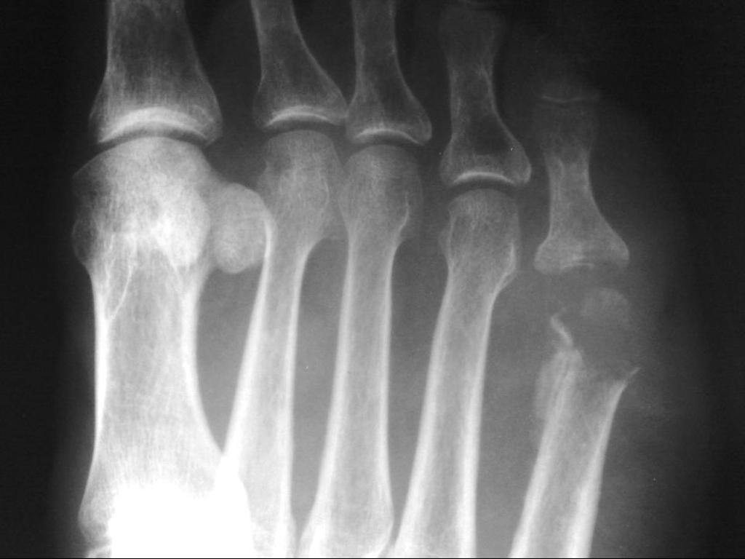
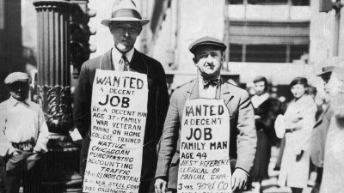
How We Got From This…
… To This

Slide 3
Case Presentation
If you figure out the case, please shout out the answer immediately

Slide 4
Chief Complaint
16M with obvious sepsis from a wound on his foot

Slide 5
HPI
Had been playing tennis – without socks – six days prior to presentation
Developed a small blister on his right foot
It became painful one day before presentation
accompanied by fever and severe body pain
appendicitis was even considered a possibility by the first physician who evaluated him

Slide 6
PMH, Meds, FH, SH
No medical problems
No meds
Nobody else sick in the family
Living with his parents and 18 year old brother
Had been at a boarding school until about a month before the onset of illness
No smoking, alcohol, or drugs
One dog
No unusual hobbies
Family situation allows for best medical care available

Slide 7
Physical exam
High fever (104-105), in pain
Benign abdomen
Remainder of physical exam normal
Small but inflamed and infected blister on the right foot
(no photos available)

Slide 8
What do you want to do?

Slide 9
Labs and Imaging
Not available

Slide 10
What do you want to do?

Slide 11
Medical Evaluation and Course
Fluids and sedation
Incision and drainage procedure made through the blister, down to the bone
Osteomyelitis on gross inspection
Drains inserted

Slide 12
POD #1
Fevers continue
Doing worse
Semi-conscious

Slide 13
What do you want to do?

Slide 14
Does anybody want to solve the case?

Slide 15
Osteomyelitis
Four forms
Acute hematogenous osteomyelitis
Acute penetrating osteomyelitis
Subacute “penetrating” osteomyelitis
Chronic osteomyelitis

Slide 16
Acute Hematogenous (Long Bone) Osteomyelitis
Almost always in children
Boys more often than girls
Legs more often than arms
Risk factors in neonates
Complicated delivery, prematurity, skin infection, central venous catheter, urinary tract anomalies, maternal infection at the time of delivery
Risk factors in older babies and children
Sepsis, minor trauma at the time of bacteremia, sickle cell disease, immunodeficiency disorders (e.g., chronic granulomatous disease), indwelling vascular catheters (including hemodialysis catheters)

Slide 17
Acute Hematogenous Osteomyelitis
Typically involves the metaphyseal plate
End-arteries, capillaries and venous sinusoids with turbulent blood flow
Vascular occlusion, ischemia, or avascular necrosis
Presence of bacteria
Can rupture outside of bone in babies

Slide 18
Acute Hematogenous Osteomyelitis
Microbiology
Infants
Staphylococcus aureus
Streptococcus agalactiae (= group B strep)
E. coli
Older babies and young children
Staphylococcus aureus
Streptococcus pyogenes
Haemophilus influenzae
Older children
Staphylococcus aureus
Streptococcus pyogenes (= group A strep)
Other streptococci

Slide 19
Acute Hematogenous (Vertebral) Osteomyelitis
The most common form in adults
From a distant site or focus of infection
Drug users
Staph aureus, occasionally Streptococcus agalactiae (group B strep) and other streptococci, Gram-negative rods and Pseudomonas aeruginosa
Infective endocarditis, degenerative spine disease, prior spinal surgery, diabetes mellitus, steroid therapy, other immunocompromised states
Other ways are penetrating, from invasive spinal diagnostic procedures, spinal surgery, or spread from adjacent soft tissue infection

Slide 20
Acute Hematogenous Osteomyelitis
Unusual causes
Coccidiodes immitis
Southwest United States (endemic)
Brucella abortus or Brucella melitensis, especially with exposure to raw milk or meats from infected animals
North Africa, Mediterranean, Middle East
Burkholderia pseudomallei
Far East, Southeast Asia, Australia

Slide 21
Acute Penetrating Osteomyelitis
Obvious pathogenesis
Microbiology
Staph aureus, various streptococci (>80%)
Special circumstances
Pseudomonas aeruginosa if there’s a penetrating injury through a sneaker
Pasturella multocida if there’s a dog or cat bite
Sporothrix schenckii with a penetrating thorn, or plant or soil injury

Slide 22
Subacute “penetrating” osteomyelitis
Diabetic foot osteomyelitis
Almost always accompanied by autonomic neuropathy, vascular insufficiency, or both
Probe to bone with a blunt instrument
Sacral bone osteomyelitis under a decubitus ulcer
Usually polymicrobial
Difficult to confirm this diagnosis (bone biopsy compared to all other diagnostic methods)
Neither of these need 6 weeks of IV antibiotics
V.L. Lewis Jr. et al. The diagnosis of osteomyelitis in patients with pressure sores. Plastic and Reconstructive Surgery. 1988; 81:229-232.
D. Wong et al. Osteomyelitis Complicating Sacral Pressure Ulcers: Whether or Not to Treat With Antibiotic Therapy. Clinical Infectious Diseases. January 15, 2019. 68:338-342.

Slide 23
Duration of Antibiotic Treatment
The usual “7 to 14 days” of antibiotics is not enough.
Four weeks is adequate for most cases
Six weeks duration is often used, but with no evidence other than four weeks isn’t always enough

Slide 24
Oral vs. Intravenous Antibiotics
Pediatrics has been using oral antibiotics (when possible) for more than three decades
Oral antibiotics also seem to work as well as intravenous antibiotics in adults
1054 patients randomized
Extra-axial, vertebral (± diskitis or adjacent soft tissue infection), prosthetic joints, and bone fixation devices
Both surgery and no surgery
1:1 randomization to
6 weeks of IV antibiotics (+ oral such as rifampin if warranted)
An appropriate oral regimen after up to 5 days of IV abx

Slide 25
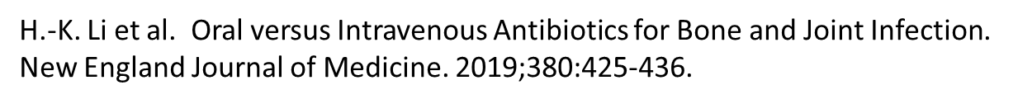
Oral vs. Intravenous Antibiotics
Microbiology:
Staph aureus 37.7%
Coagulase-negative staph 27.1%
Streptococci 14.5%
Pseudomonas aeruginosa 5.1%
Enteric Gram-negative rods 16.7%
Culture-negative 15.5%
Primary endpoint: treatment failure (clinical microbiological, and histologic criteria) within one year
Intravenous antibiotics: 14.6%
Oral antibiotics: 13.2%

Slide 26
Oral vs. Intravenous Antibiotics
Challenge for I.D. physicians: selecting the “right” oral antibiotic
High bioavailability
Good tissue penetration
Activity against the known or likely pathogens
…but no organism
Microbiology:
Staph aureus 37.7%, coagulase-negative staph 27.1%, streptococci 14.5%
Pseudomonas aeruginosa 5.1%, enteric Gram-negative rods 16.7%
culture-negative 15.5%

Slide 27
Chronic Osteomyelitis
Sinus tract formation, abscesses, bone deformities
Cure is possible only with surgery or luck
General goal is to reduce the number of bacteria and control symptoms (e.g., pain, drainage from a sinus)

Slide 28
Osteomyelitis – Miscellaneous
Bartonella henselae in children with cat-scratch disease
Encapsulated Gram-negative rods (Salmonella, E. coli, Haemophilus influenzae) in children with sickle cell disease
Coccidioides immitis
Aspergillus spp. in children with CGD

Slide 29
Osteomyelitis
A disease primarily caused by Staph aureus and various streptococci
F.D.A. requirements for antibiotics to treat osteomyelitis
Activity against Gram-positive cocci
Typical equivalence study
Antibiotics for other bacteria at the discretion of the local investigator, but can’t have activity against Gram-positive cocci

Slide 30
Osteomyelitis
A disease primarily caused by Staph aureus and various streptococci
F.D.A. requirements for antibiotics to treat osteomyelitis
Activity against Gram-positive cocci
Typical equivalence study
Antibiotics for other bacteria at the discretion of the local investigator, but can’t have activity against Gram-positive cocci
One year follow-up required

Slide 31
Septic arthritis
Native joint
Severe sepsis unusual
Prosthetic joint
Severe sepsis extremely rare
Both with negative cultures more than we like

Slide 32
Septic arthritis
Predisposing factors
Age >80 years
Diabetes mellitus
Rheumatoid arthritis
Prosthetic joint
Recent joint surgery
Skin infection
Intravenous drug use
Alcoholism
Intraarticular corticosteroid injection

Slide 33
Joint Infections – Pathogenesis
Hematogenous spread
No limiting basement layer to synovial tissue
Bacterial quickly get into synovial fluid, causing acute joint inflammation and purulence, marked hyperplasia of the synovium within seven days, release of cytokines and proteases that cause cartilage damage, and pressure necrosis from large synovial effusions
Penetrating trauma
Inoculation of bacteria during joint surgery
Treat this as another type of disease, i.e., pyogenic arthritis vs. prosthetic joint infection

Slide 34
Joint Infections – Microbiology
Staphylococcus aureus
Various Strep species
Neisseria gonorrhoeae

Slide 35
Joint Infections – Diagnosis
Get the fluid!
Normal joints contain a small volume of synovial fluid: highly viscous, clear, and acellular
There is no reason to start antibiotics before obtaining fluid

Slide 36
Joint Infections – Diagnosis
Crystals
Gram stain sensitivity 29 to 50%
Crystals
Use a polarizing microscope
Uric acid (gout): brightly birefringent and needle-shaped
Calcium pyrophosphate (pseudogout): moderately birefringent and either rhomboidal or rectangular
White blood cells >2000, >20,000, >50,000
Septic, crystal, acute rheumatoid, lupus, or Lyme
But a clinical diagnosis can easily be made
Glucose and protein are not particularly helpful

Slide 37
Back to the Patient
Organism?

Slide 38
Back to the Patient
Organism?
Staphylococcus aureus

Slide 39
Back to the Patient
Now, the tougher question:

Slide 40
Back to the Patient
Now, the tougher question:
How did this cause the Great Depression?

Slide 41
Back to the Patient
Or…
Who is the patient?

Slide 42
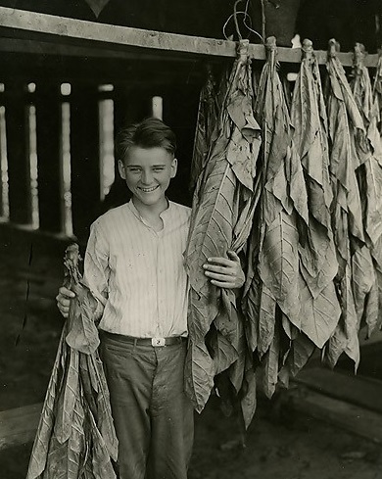
Back to the Patient
At a summer job working on a tobacco farm, age 15

Slide 43
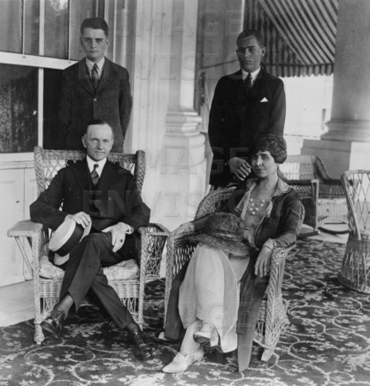
Back to the Patient
Family photo (patient at upper left)

Slide 44
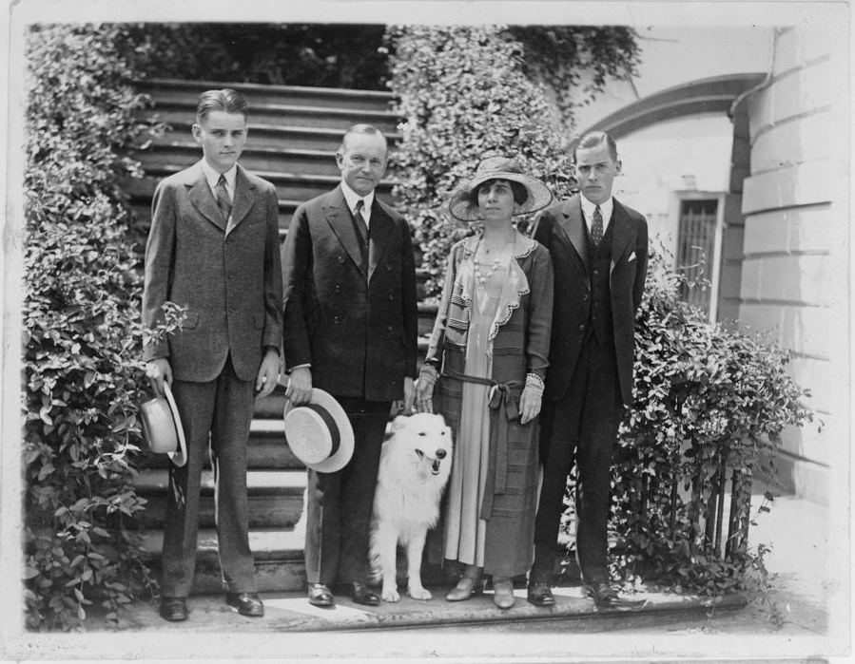
Back to the Patient

Slide 45
Back to the Patient
July 1924
No antibiotics

Slide 46
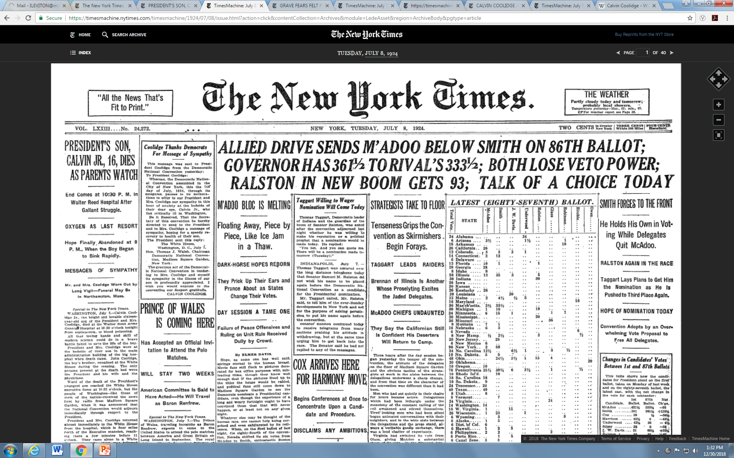

Slide 48
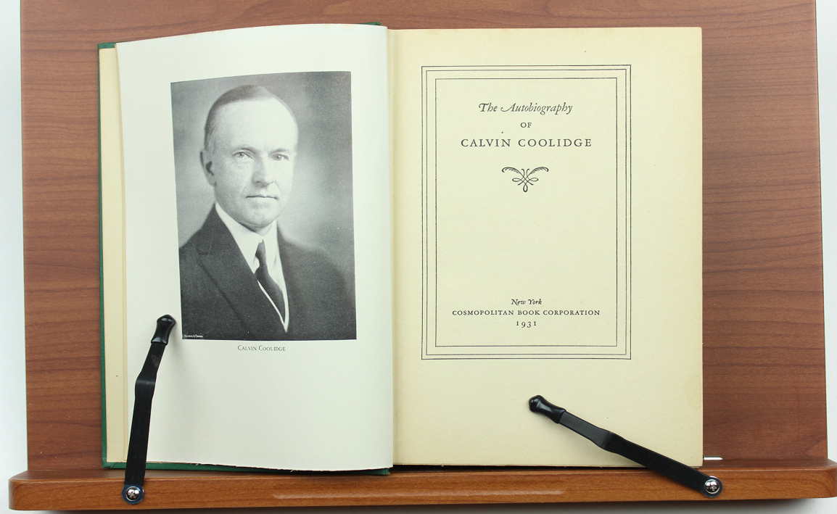
Quotations by Calvin Coolidge
"When he [Calvin Jr.] died, the power and the glory of the Presidency went with him.”
Calvin Coolidge, autobiography, 1931

Slide 49
Quotations by Calvin Coolidge
"I do not choose to run for president in 1928.“
Calvin Coolidge, August 2, 1927

Slide 50
Quotations by Calvin Coolidge
“You lose.”

Slide 51
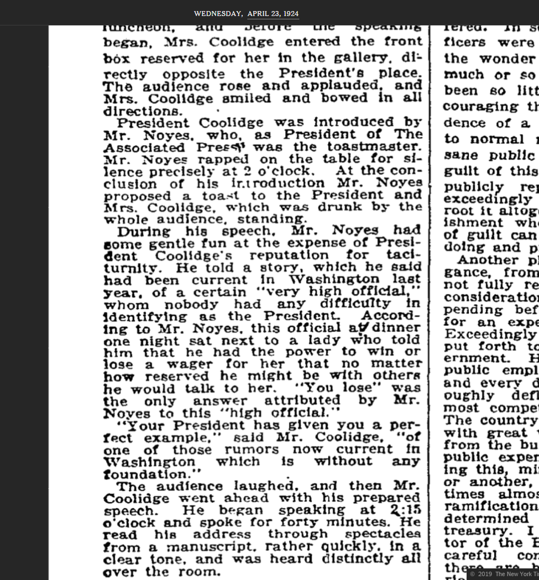
Quotations by Calvin Coolidge
“You lose.”
He never said it.

Slide 52
Timeline
August 3, 1923: Calvin Coolidge Sr. becomes president after the death of Warren Harding
July 7, 1924: Calvin Coolidge Jr. dies
August 2, 1927: Calvin Coolidge Sr. chooses not to run
November 6, 1928: Herbert Hoover elected
March 4, 1929: Herbert Hoover inaugurated
September 3, 1929: Dow Jones = 381.17
July 8, 1932: Dow Jones = 41.22

Slide 53

And That… Is How Osteomyelitis Caused the Great Depression

Slide 54
Citations
F.A. Waldvogel et al. Osteomyelitis: a review of clinical features, therapeutic considerations and unusual aspects. New England Journal of Medicine. 1970;282:198-206, 260-266, and 316-322. (PMID 4902833, 4903106, and 4987436, doi 10.1056/NEJM197001222820406, 10.1056/NEJM197001292820507, and 10.1056/NEJM197002052820606)
V.L. Lewis Jr. et al. The diagnosis of osteomyelitis in patients with pressure sores. Plastic and Reconstructive Surgery. 1988; 81:229-232. (PMID 3336654, doi 10.1097/00006534-198802000-00016)
H.-K. Li et al. Oral versus Intravenous Antibiotics for Bone and Joint Infection. New England Journal of Medicine. January 31, 2019. 380:425-436. (PMID 30699315 doi 10.1056/NEJMoa1710926)
D. Wong et al. Osteomyelitis Complicating Sacral Pressure Ulcers: Whether or Not to Treat With Antibiotic Therapy. Clinical Infectious Diseases. January 15, 2019. 68:338-342. (PMID 29986022, doi 10.1093/cid/ciy559)
N.W. Cortés-Penfield. The History of Antibiotic Treatment of Osteomyelitis. Open Forum Infectious Diseases. May 2019. 6:ofz181. (PMID 31123692, doi 10.1093/ofid/ofz181)
M.C. Fisher et al. Sneakers as a source of Pseudomonas aeruginosa in children with osteomyelitis following puncture wounds. J Pediatrics. April 1985. 106:607-609. (PMID 3920373, doi 10.1016/s0022-3476(85)80082-2)
President’s Son, Calvin Jr., 16, Dies as Parents Watch. New York Times. July 8, 1924. 78:1-8.
Coolidge for a New Arms Conference; Demands Constructive Federal Thrift; Favors Participation in German Loan. New York Times. April 23, 1924. 78:1-2.
C. Coolidge. The Autobiography of Calvin Coolidge. Cosmopolitan Book Corporation. 1929:190.

